Slide 1

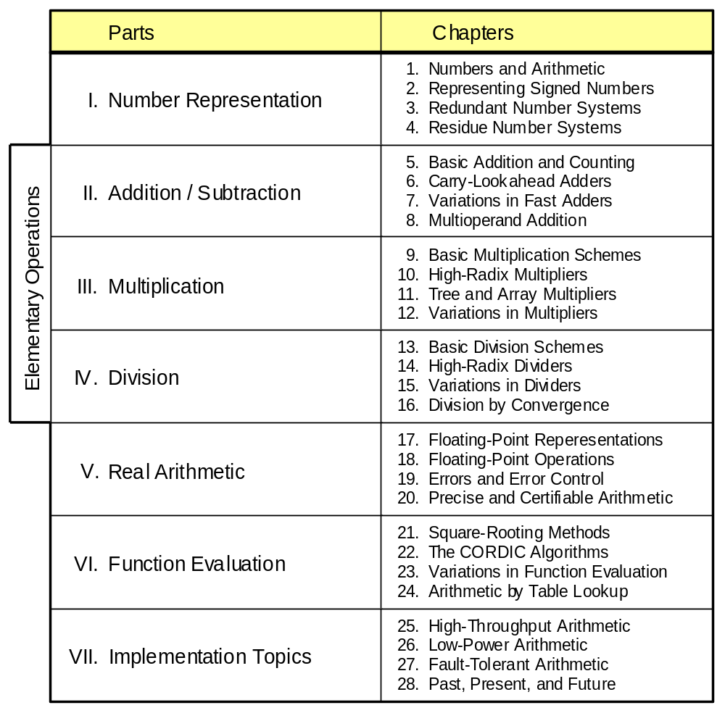
Part VII
Implementation Topics

Slide 2
About This Presentation
This presentation is intended to support the use of the textbook Computer Arithmetic: Algorithms and Hardware Designs (Oxford University Press, 2000, ISBN 0-19-512583-5). It is updated regularly by the author as part of his teaching of the graduate course ECE 252B, Computer Arithmetic, at the University of California, Santa Barbara. Instructors can use these slides freely in classroom teaching and for other educational purposes. Unauthorized uses are strictly prohibited. © Behrooz Parhami
Edition | Released | Revised | Revised | Revised | Revised
First | Jan. 2000 | Sep. 2001 | Sep. 2003 | Oct. 2005

Slide 3
VII Implementation Topics
Sample advanced implementation methods and tradeoffs
  Speed / latency is seldom the only concern
  We also care about throughput, size, power, reliability
  Case studies: arithmetic in micros to supers
  Lessons from the past, and a peek into the future
Topics in This Part
Chapter 25 High-Throughput Arithmetic
Chapter 26 Low-Power Arithmetic
Chapter 27 Fault-Tolerant Arithmetic
Chapter 28 Past, Present, and Future

Slide 4
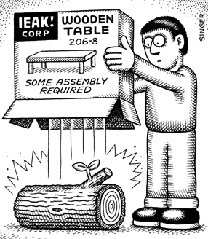
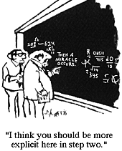

Slide 5
25 High-Throughput Arithmetic
Chapter Goals
Learn how to improve the performance of
an arithmetic unit via higher throughput
rather than reduced latency
Chapter Highlights
To improve overall performance, one must
• Look beyond individual operations
• Trade off latency for throughput
For example, a multiply may take 20 cycles,
but a new one can begin every cycle
Data availability and hazards limit the depth

Slide 6
High-Throughput Arithmetic: Topics
Topics in This Chapter
25.1. Pipelining of Arithmetic Functions
25.2. Clock Rate and Throughput
25.3. The Earle Latch
25.4. Parallel and Digit-Serial Pipelines
25.5. On-Line of Digit-Pipelined Arithmetic
25.6. Systolic Arithmetic Units

Slide 7
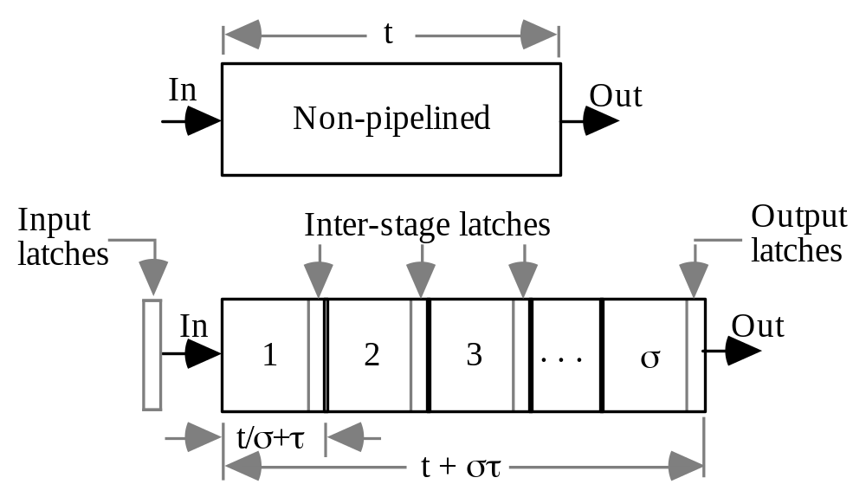
25.1 Pipelining of Arithmetic Functions
Fig. 25.1 An arithmetic function unit and its σ-stage pipelined version.
Throughput
Operations per unit time
Pipelining period
Interval between applying successive inputs
Latency, though a secondary consideration, is still important because:
a. Occasional need for doing single operations
b. Dependencies may lead to bubbles or even drainage
At times, pipelined implementation may improve the latency of a multistep computation and also reduce its cost; in this case, advantage is obvious

Slide 8
Analysis of Pipelining Throughput
Consider a circuit with cost (gate count) g and latency t
Simplifying assumptions for our analysis:
1. Time overhead per stage is τ (latching delay)
2. Cost overhead per stage is γ (latching cost)
3. Function is divisible into σ equal stages for any σ
Then, for the pipelined implementation:
Latency T = t + στ
1 1
Throughput R = =
T / σ t / σ + τ
Cost G = g + σγ
Throughput approaches its maximum of 1/τ for large σ
Fig. 25.1

Slide 9
Analysis of Pipelining Cost-Effectiveness
1 1
T = t + στR = = G = g + σγ
T / σ t / σ + τ
Latency Throughput Cost
Consider cost-effectiveness to be throughput per unit cost
E = R / G = σ / [(t + στ)(g + σγ)]
To maximize E, compute dE/dσ and equate the numerator with 0
tg – σ²τγ = 0 ⇒ σ^{opt} = √ tg / (τγ)
We see that the most cost-effective number of pipeline stages is:
Directly related to the latency and cost of the function;
it pays to have many stages if the function is very slow or complex
Inversely related to pipelining delay and cost overheads;
few stages are in order if pipelining overheads are fairly high
All in all, not a surprising result!

Slide 10
25.2 Clock Rate and Throughput
Consider a σ-stage pipeline with stage delay t_{stage}
One set of inputs is applied to the pipeline at time t₁
At time t₁ + t_{stage} + τ, partial results are safely stored in latches
Apply the next set of inputs at time t₂ satisfying t₂ ≥ t₁ + t_{stage} + τ
Therefore:
Clock period = Δt = t₂ – t₁ ≥ t_{stage} + τ
Throughput = 1/ Clock period ≤ 1/(t_{stage} + τ)
Fig. 25.1

Slide 11
The Effect of Clock Skew on Pipeline Throughput
Two implicit assumptions in deriving the throughput equation below:
One clock signal is distributed to all circuit elements
All latches are clocked at precisely the same time
Throughput = 1/ Clock period
≤ 1/(t_{stage} + τ)
Fig. 25.1
Uncontrolled or random clock skew
causes the clock signal to arrive at
point B before/after its arrival at point A
With proper design, we can place a bound ±ε on the uncontrolled clock skew at the input and output latches of a pipeline stage
Then, the clock period is lower bounded as:
Clock period = Δt = t₂ – t₁ ≥ t_{stage} + τ + 2ε

Slide 12
Wave Pipelining: The Idea
The stage delay t_{stage} is really not a constant but varies from t_{min} to t_{max}
t_{min} represents fast paths (with fewer or faster gates)
t_{max} represents slow paths
Suppose that one set of inputs is applied at time t₁
At time t₁ + t_{max} + τ, the results are safely stored in latches
If that the next inputs are applied at time t₂, we must have:
t₂ + t_{min} ≥ t₁ + t_{max} + τ
This places a lower bound on the clock period:
Clock period = Δt = t₂ – t₁ ≥ t_{max} – t_{min} + τ
Thus, we can approach the maximum possible pipeline throughput of 1/τ without necessarily requiring very small stage delay
All we need is a very small delay variance t_{max} – t_{min}
Two roads to higher pipeline throughput:
Reducing t_{max}
Increasing t_{min}

Slide 13
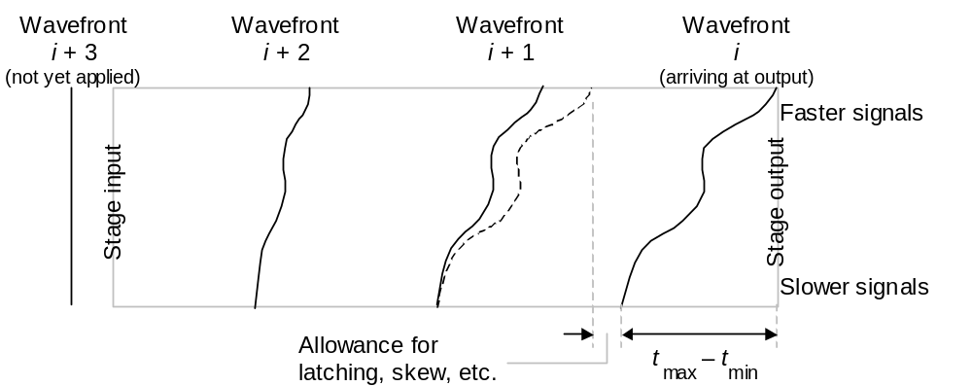
Visualizing Wave Pipelining
Fig. 25.2 Wave pipelining allows multiple computational wavefronts to coexist in a single pipeline stage .

Slide 14
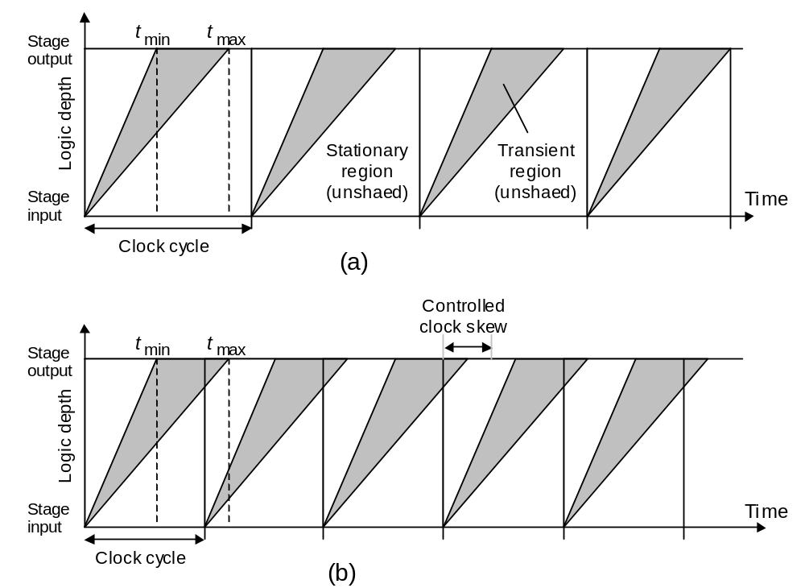
Another Visualization of Wave Pipelining
Stationary
region
(unshaded)
Transient
region
(shaded)
(a) Ordinary pipelining
Fig. 25.3 Alternate view of the throughput advantage of wave pipelining over ordinary pipelining.
(b) Wave pipelining

Slide 15
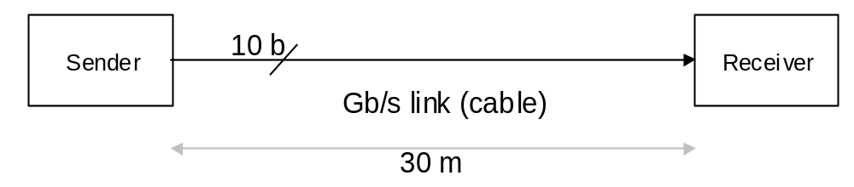
Difficulties in Applying Wave Pipelining
LAN and other high-speed links
(figures rounded from Myrinet data [Bode95])
Gb/s throughput → Clock rate = 10⁸ → Clock cycle = 10 ns
In 10 ns, signals travel 1-1.5 m (speed of light = 0.3 m/ns)
For a 30 m cable, 20-30 characters will be in flight at the same time
At the circuit and logic level (μm-mm distances, not m), there are still problems to be worked out
For example, delay equalization to reduce t_{max} – t_{min} is nearly impossible in CMOS technology:
CMOS 2-input NAND delay varies by factor of 2 based on inputs
Biased CMOS (pseudo-CMOS) fairs better, but has power penalty

Slide 16
Controlled Clock Skew in Wave Pipelining
With wave pipelining, a new input enters the pipeline stage every
Δt time units and the stage latency is t_{max} + τ
Thus, for proper sampling of the results, clock application at the output latch must be skewed by (t_{max} + τ) mod Δt
Example: t_{max} + τ = 12 ns; Δt = 5 ns
A clock skew of +2 ns is required at the stage output latches relative to the input latches
In general, the value of t_{max} – t_{min} > 0 may be different for each stage
Δt ≥ max_{i=1 to σ} [t_{max}^{(i)} – t_{min}^{(i)} + τ]
The controlled clock skew at the output of stage i needs to be:
S^{(i)} = ∑_{j=1 to i} [t_{max}^{(i)} – t_{min}^{(i)} + τ] mod Δt

Slide 17
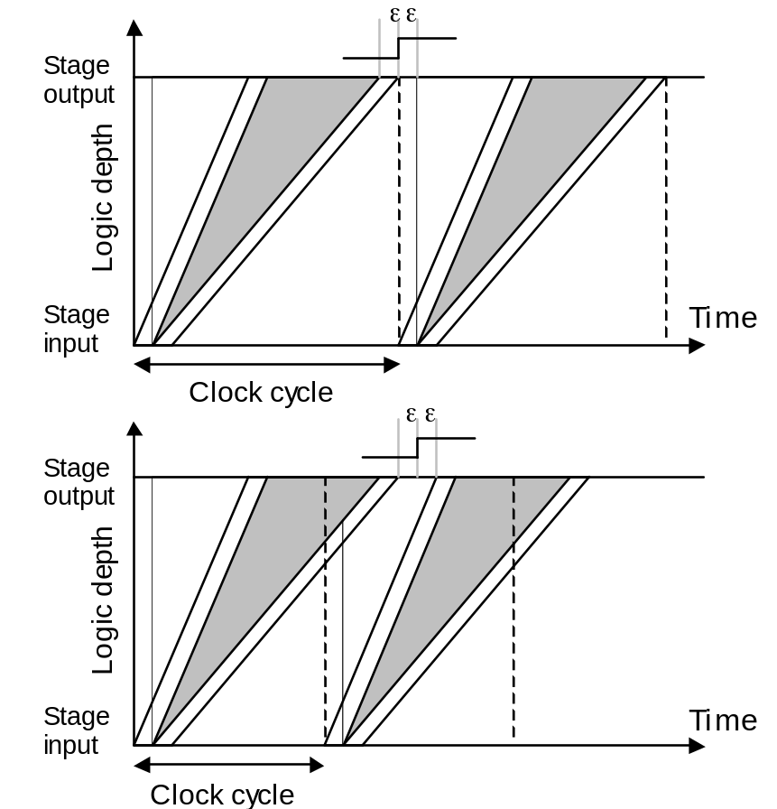
Random Clock Skew in Wave Pipelining
Clock period = Δt = t₂ – t₁
≥ t_{max} – t_{min} + τ + 4ε
Reasons for the term 4ε:
Clocking of the first input set may lag by ε, while that of the second set leads by ε (net difference = 2ε)
The reverse condition may exist at the output side
Uncontrolled skew has a larger effect on wave pipelining than on standard pipelining, especially when viewed in relative terms
Graphical justification of the term 4ε

Slide 18
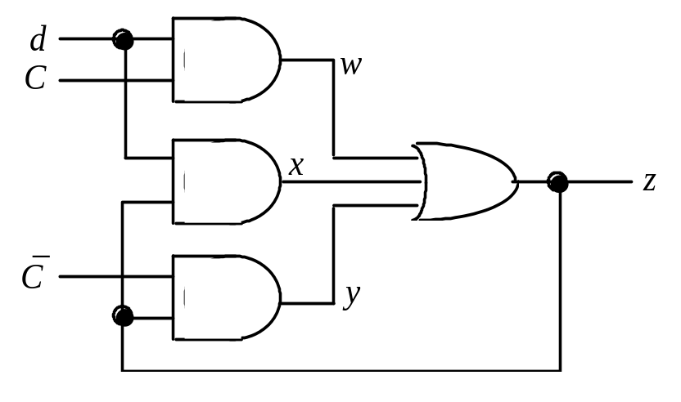
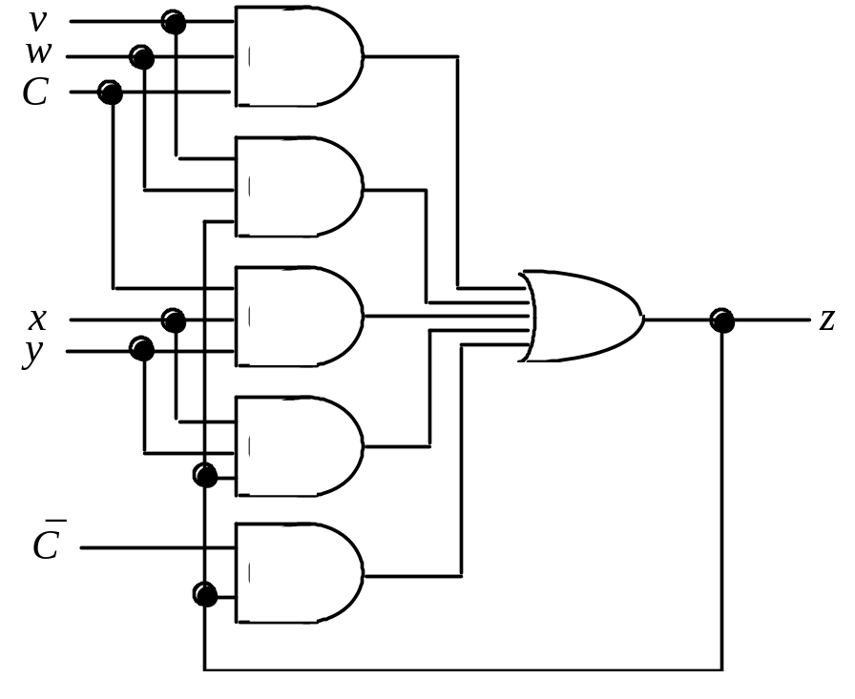
25.3 The Earle Latch
Earle latch can be merged with a preceding 2-level AND-OR logic
Fig. 25.4 Two-level AND-OR realization of the Earle latch.
Example: To latch d = vw + xy, substitute for d in the latch equation
z = dC + dz +‾Cz
to get a combined “logic + latch” circuit implementing z = vw + xy
z = (vw + xy)C + (vw + xy)z +‾Cz
= vwC + xyC + vwz + xyz +‾Cz
Fig. 25.5 Two-level AND-OR latched realization of the function z = vw + xy.

Slide 19
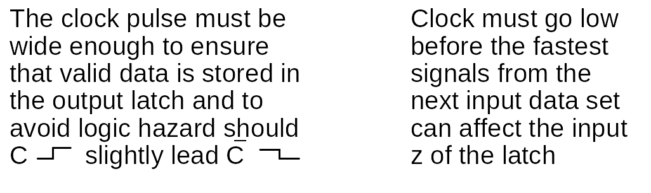
Clocking Considerations for Earle Latches
We derived constraints on the maximum clock rate 1/Δt
Clock period Δt has two parts: clock high, and clock low
Δt = C_{high} + C_{low}
Consider a pipeline stage between Earle latches
C_{high} must satisfy the inequalities
3δ_{max} – δ_{min} + S_{max}(C↑,‾C↓) ≤ C_{high} ≤ 2δ_{min} + t_{min}
δ_{max} and δ_{min} are maximum and minimum gate delays
S_{max}(C↑,‾C↓) ≥ 0 is the maximum skew between C↑ and‾C↓

Slide 20
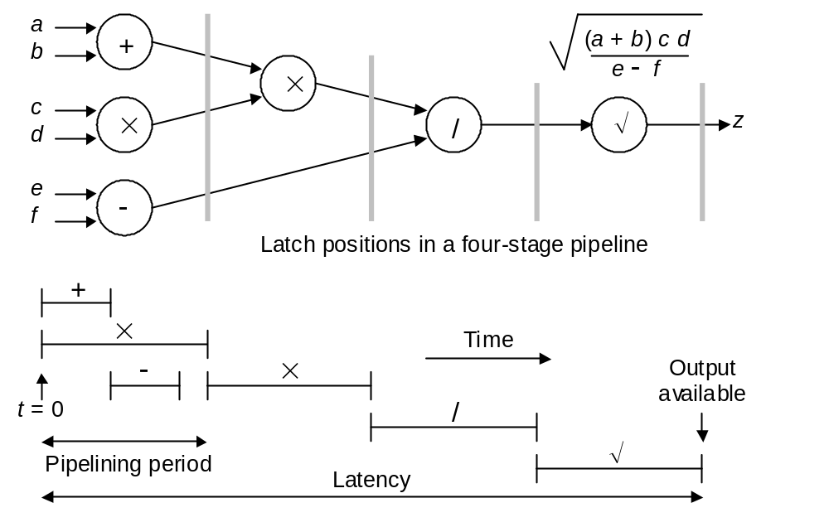
25.4 Parallel and Digit-Serial Pipelines
Fig. 25.6 Flow-graph representation of an arithmetic expression and timing diagram for its evaluation with digit-parallel computation.

Slide 21
Feasibility of Bit-Level or Digit-Level Pipelining
Bit-serial addition and multiplication can be done LSB-first, but division and square-rooting are MSB-first operations
Besides, division can’t be done in pipelined bit-serial fashion, because the MSB of the quotient q in general depends on all the bits of the dividend and divisor
Example: Consider the decimal division .1234/.2469
.1xxx
-------- = .?xxx
.2xxx
.12xx
-------- = .?xxx
.24xx
.123x
-------- = .?xxx
.246x
Solution: Redundant number representation!

Slide 22
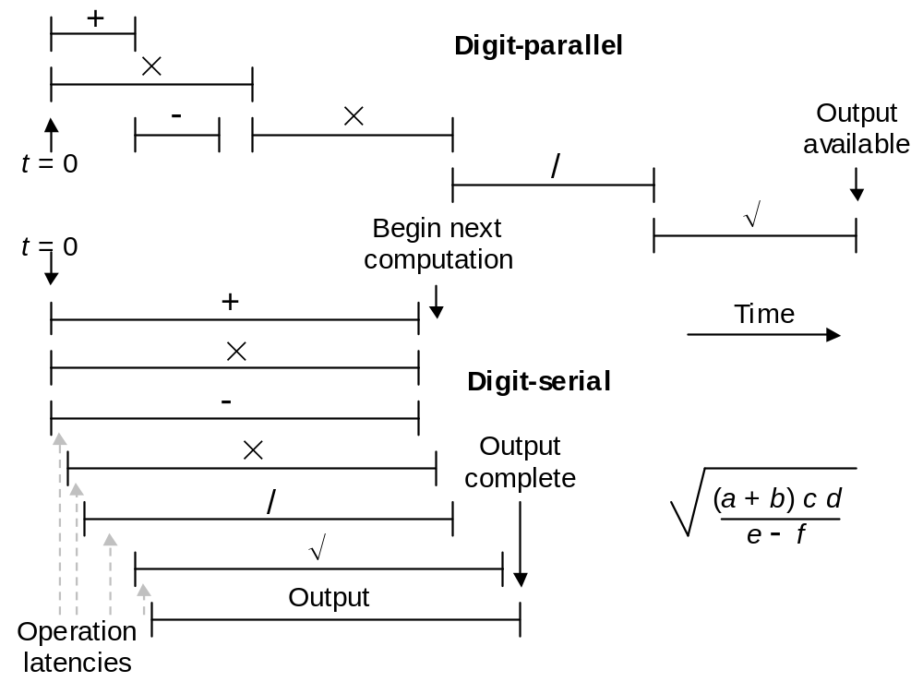
25.5 On-Line or Digit-Pipelined Arithmetic
Fig. 25.7 Digit-parallel versus digit-pipelined computation.

Slide 23
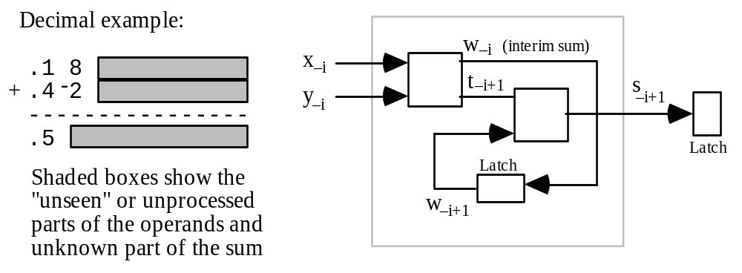
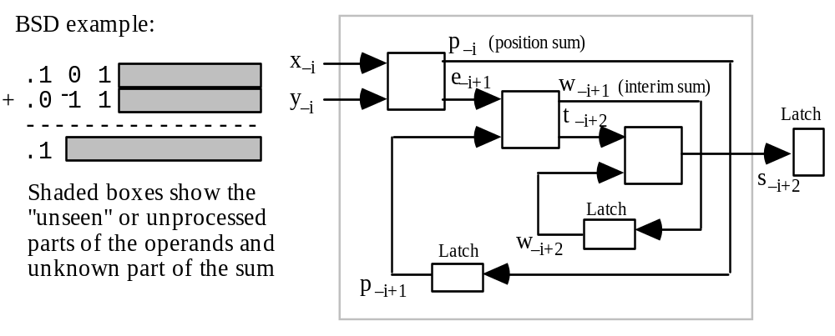
Digit-Pipelined Adders
Fig. 25.8
Digit-pipelined
MSD-first
carry-free
addition.
Fig. 25.9
Digit-pipelined
MSD-first
limited-carry
addition.

Slide 24
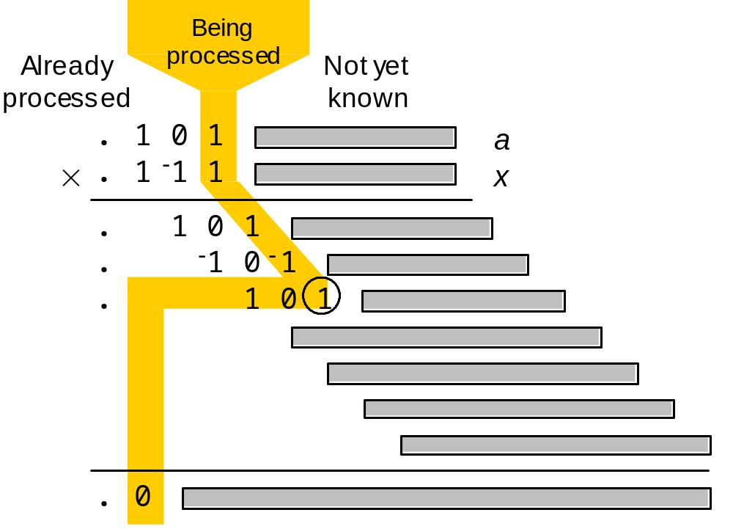
Digit-Pipelined Multiplier: Algorithm Visualization
Fig. 25.10 Digit-pipelined MSD-first multiplication process.

Slide 25
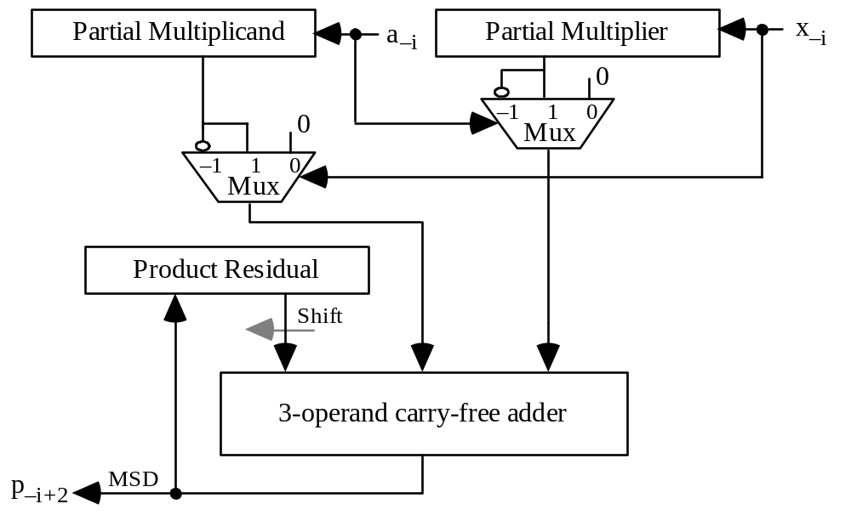
Digit-Pipelined Multiplier: BSD Implementation
Fig. 25.11
Digit-pipelined MSD-first BSD multiplier.

Slide 26
Digit-Pipelined Divider
Table 25.1 Example of digit-pipelined division showing that three cycles of delay are necessary before quotient digits can be output (radix = 4, digit set = [–2, 2])
––––––––––––––––––––––––––––––––––––––––––––––––––––––––––
Cycle Dividend Divisor q Range q_{–1} Range
––––––––––––––––––––––––––––––––––––––––––––––––––––––––––
1 (.0 . . .)_{four} (.1 . . .)_{four} (–2/3, 2/3) [–2, 2]
2 (.0 0 . . .)_{four} (.1–2 . . .)_{four} (–2/4, 2/4) [–2, 2]
3 (.0 0 1 . . .)_{four} (.1–2–2 . . .)_{four} (1/16, 5/16) [0, 1]
4 (.0 0 1 0 . . .)_{four} (.1–2–2–2 . . .)_{four} (10/64, 14/64) 1
––––––––––––––––––––––––––––––––––––––––––––––––––––––––––

Slide 27
Digit-Pipelined Square-Rooter
Table 25.2 Examples of digit-pipelined square-root computation showing that 1-2 cycles of delay are necessary before root digits can be output (radix = 10, digit set = [–6, 6], and radix = 2, digit set = [–1, 1])
–––––––––––––––––––––––––––––––––––––––––––––––––––––––
Cycle Radicand q Range q_{–1} Range
–––––––––––––––––––––––––––––––––––––––––––––––––––––––
1 (.3 . . .)_{ten} (√ 7/30 , √ 11/30 ) [5, 6]
2 (.3 4 . . .)_{ten} (√ 1/3 , √ 26/75 ) 6
–––––––––––––––––––––––––––––––––––––––––––––––––––––––
1 (.0 . . .)_{two} (0, √ 1/2 ) [–2, 2]
2 (.0 1 . . .)_{two} (0, √ 1/2 ) [0, 1]
3 (.0 1 1 . . .)_{two} (1/2, √ 1/2 ) 1
–––––––––––––––––––––––––––––––––––––––––––––––––––––––

Slide 28
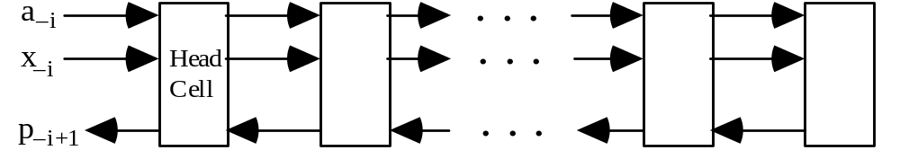
25.6 Systolic Arithmetic Units
Systolic arrays: Cellular circuits in which data elements
Enter at the boundaries
Advance from cell to cell in lock step
Are transformed in an incremental fashion
Leave from the boundaries
Systolic design mitigates the effect of signal propagation delay and allows the use of very clock rates
Fig. 25.12 High-level design of a systolic radix-4 digit-pipelined multiplier.

Slide 29
26 Low-Power Arithmetic
Chapter Goals
Learn how to improve the power efficiency
of arithmetic circuits by means of
algorithmic and logic design strategies
Chapter Highlights
Reduced power dissipation needed due to
• Limited source (portable, embedded)
• Difficulty of heat disposal
Algorithm and logic-level methods: discussed
Technology and circuit methods: ignored here

Slide 30
Low-Power Arithmetic: Topics
Topics in This Chapter
26.1. The Need for Low-Power Design
26.2. Sources of Power Consumption
26.3. Reduction of Power Waste
26.4. Reduction of Activity
26.5. Transformations and Tradeoffs
26.6. Some Emerging Methods

Slide 31
26.1 The Need for Low-Power Design
Portable and wearable electronic devices
Nickel-cadmium batteries: 40-50 W-hr per kg of weight
Practical battery weight < 1 kg (< 0.1 kg if wearable device)
Total power ≅ 3-5 W for a day’s work between recharges
Modern high-performance microprocessors use 10s Watts
Power is proportional to die area × clock frequency
Cooling of micros not yet a problem; but for MPPs . . .
New battery technologies cannot keep pace with demand
Demand for more speed and functionality (multimedia, etc.)
-

Slide 32
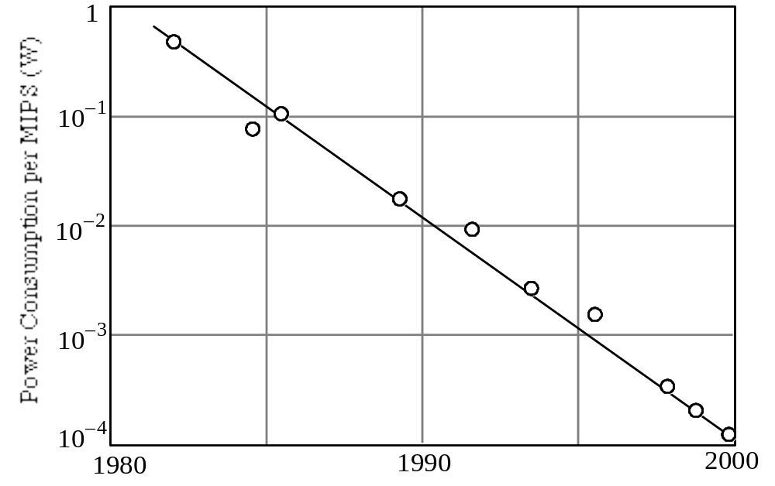
Processor Power Consumption Trends
Power consumption per MIPS (W)
Fig. 26.1 Power consumption trend in DSPs [Raba98].

Slide 33
26.2 Sources of Power Consumption
Both average and peak power are important
Average power determines battery life or heat dissipation
Peak power impacts power distribution and signal integrity
Typically, low-power design aims at reducing both
Power dissipation in CMOS digital circuits
Static: Leakage current in imperfect switches (< 10%)
Dynamic: Due to (dis)charging of parasitic capacitance
P_{avg} ≅ α f C V ²
Square of voltage
“activity”
data rate
(clock frequency)
Capacitance

Slide 34
Power Reduction Strategies: The Big Picture
For a given data rate f, there are but 3 ways to reduce the power requirements:
1. Using a lower supply voltage V
2. Reducing the parasitic capacitance C
3. Lowering the switching activity α
P_{avg} ≅ α f C V ²
Example: A 32-bit off-chip bus operates at 5 V and 100 MHz and drives a capacitance of 30 pF per bit. If random values were put on the bus in every cycle, we would have α = 0.5. To account for data correlation and idle bus cycles, assume α = 0.2. Then:
P_{avg} ≅ α f C V ² = 0.2 × 10⁸ × (32 × 30 × 10^{–12}) × 5² = 0.48 W

Slide 35
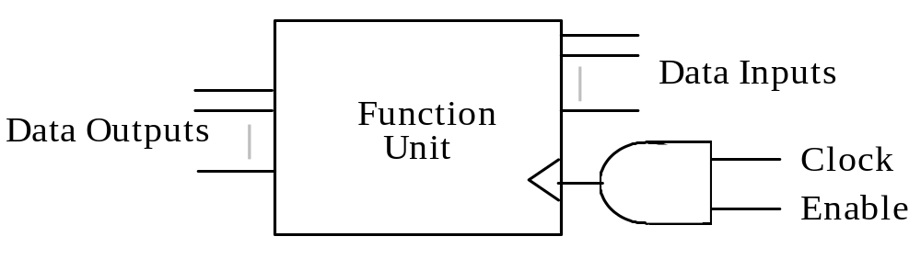
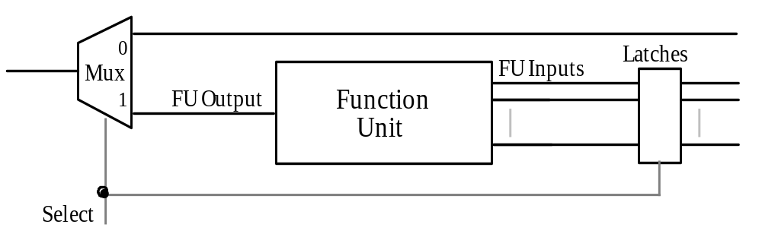
26.3 Reduction of Power Waste
Fig. 26.2 Saving power through clock gating.
Fig. 26.3 Saving power via guarded evaluation.

Slide 36
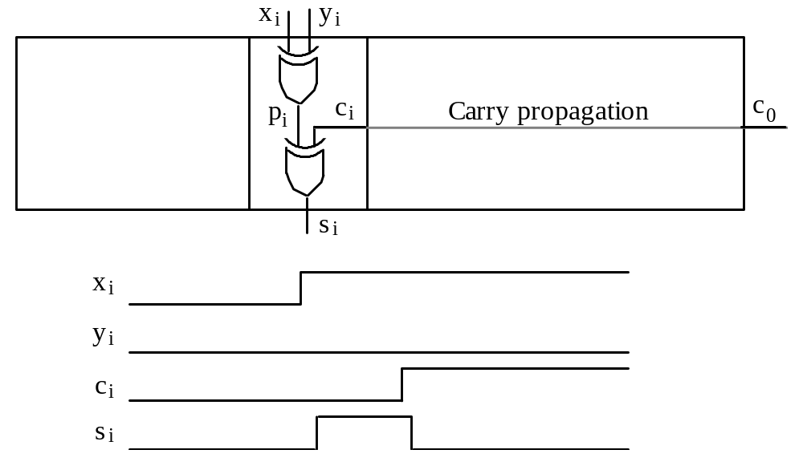
Glitching and Its Impact on Power Waste
Fig. 26.4 Example of glitching in a ripple-carry adder.

Slide 37
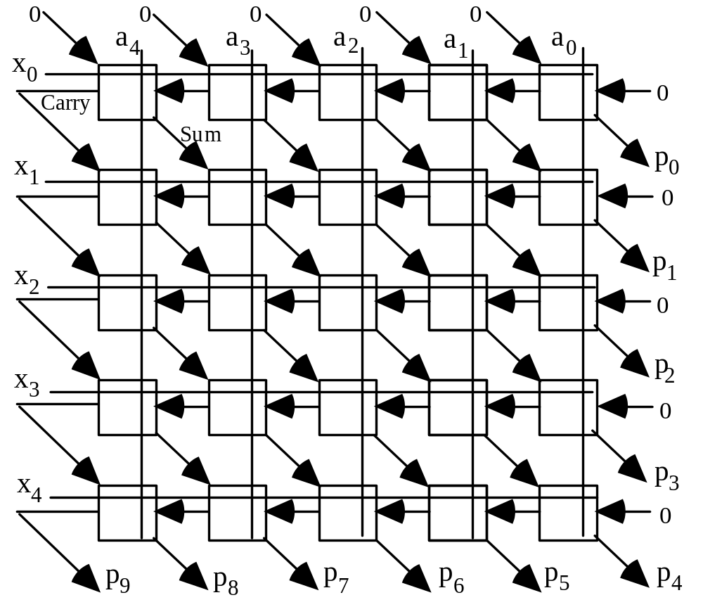
Array Multipliers with Lower Power Consumption
Fig. 26.5 An array multiplier with gated FA cells.

Slide 38
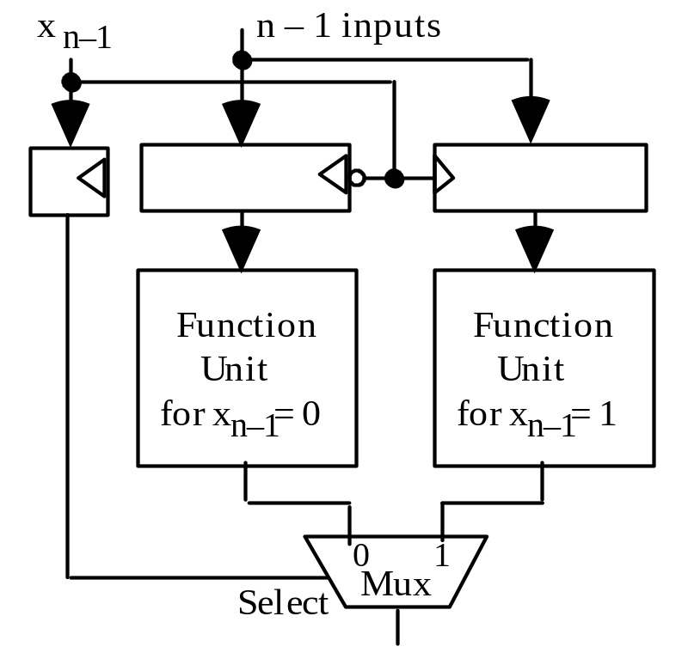
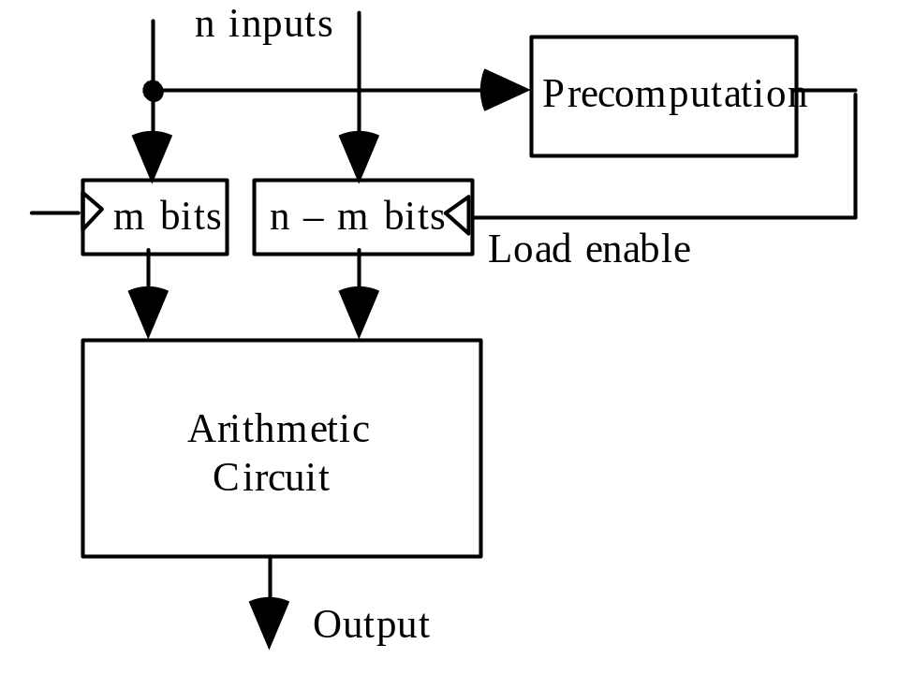
26.4 Reduction of Activity
Fig. 26.6 Reduction of activity by precomputation.
Fig. 26.7 Reduction of activity via Shannon expansion.

Slide 39
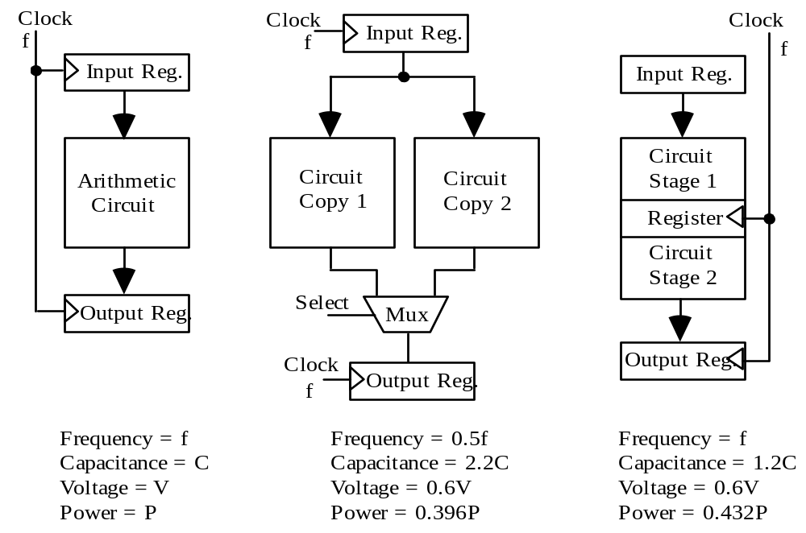
26.5 Transformations and Tradeoffs
Fig. 26.8 Reduction of power via parallelism or pipelining.

Slide 40
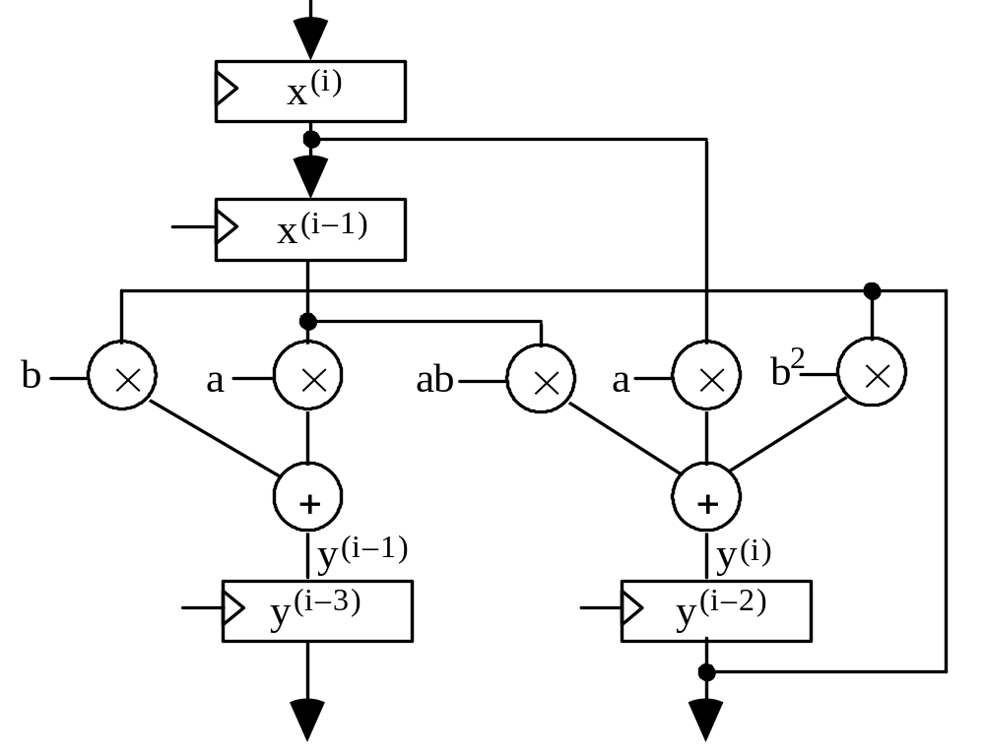
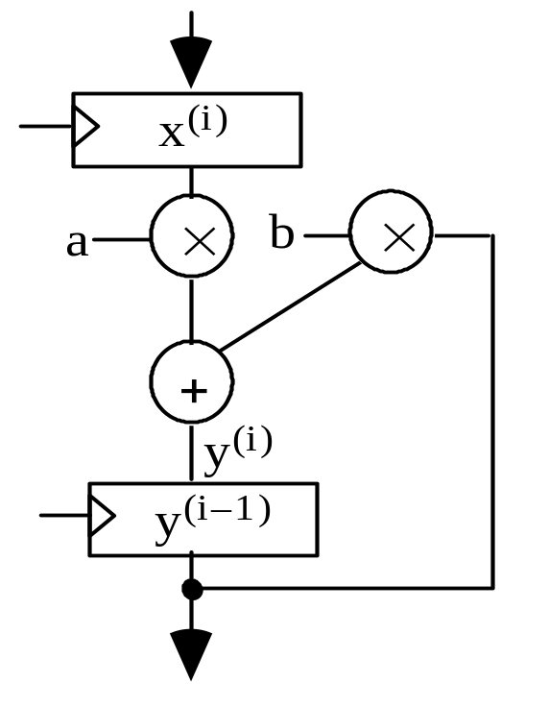
Unrolling of Iterative Computations
Fig. 26.9 Direct realization of a first-order IIR filter.
Fig. 26.10 Realization of a first-order filter, unrolled once.

Slide 41
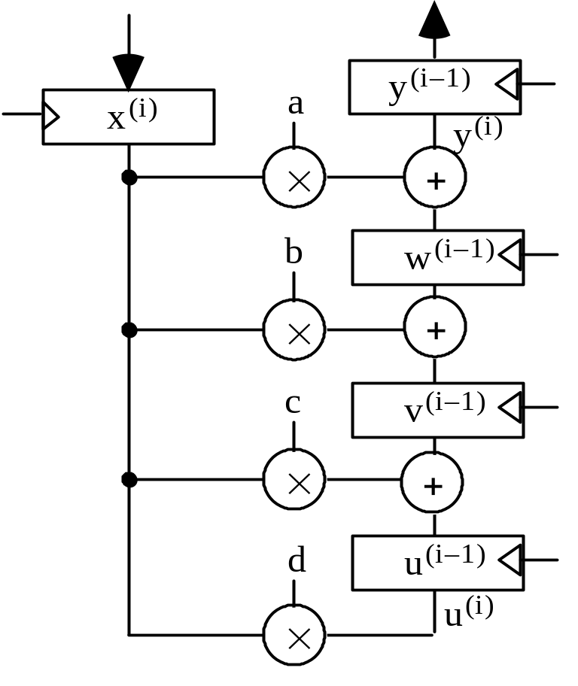
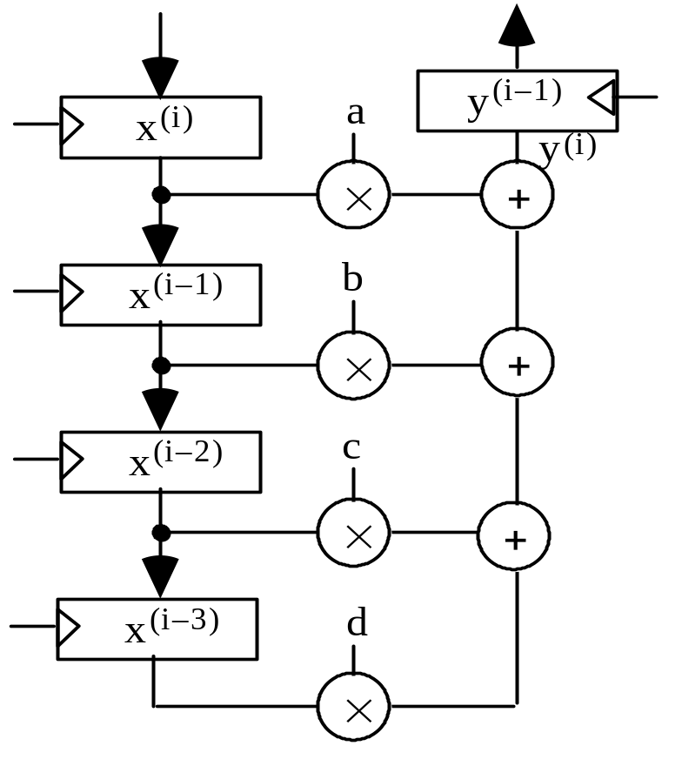
Retiming for Power Efficiency
Fig. 26.11 Possible realization of a fourth-order FIR filter.
Fig. 26.12 Realization of the retimed fourth-order FIR filter.

Slide 42
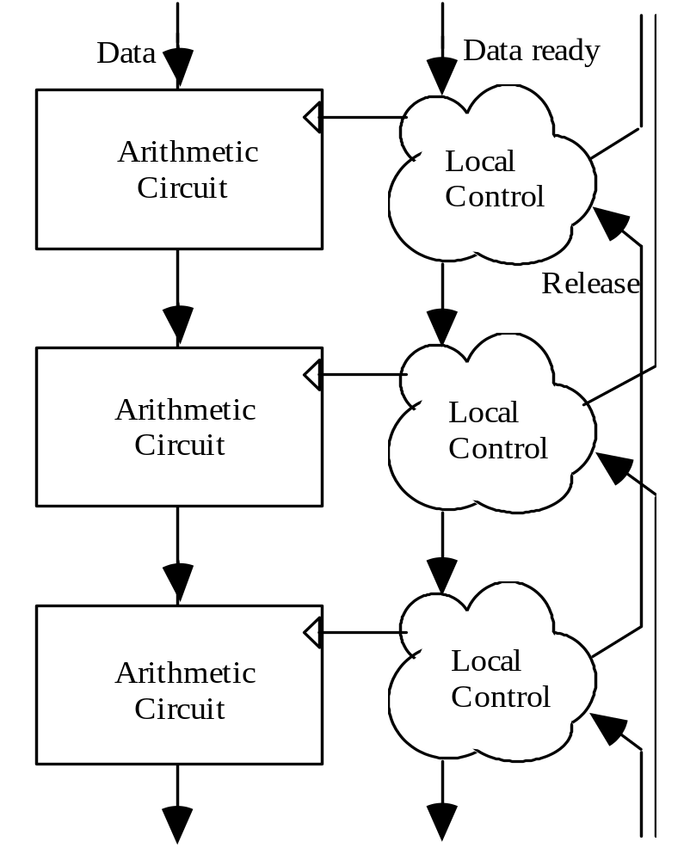
26.6 Some Emerging Methods
Dual-rail data encoding with transition signaling:
Two wires per signal
Transition on wire 0 (1) indicates the arrival of 0 (1)
Dual-rail design does increase the wiring density, but it offers the advantage of complete insensitivity to delays
Fig. 26.13 of an asynchronous chain of computations.

Slide 43
27 Fault-Tolerant Arithmetic
Chapter Goals
Learn about errors due to hardware faults
or hostile environmental conditions,
and how to deal with or circumvent them
Chapter Highlights
Modern components are very robust, but . . .
put millions / billions of them together
and something is bound to go wrong
Can arithmetic be protected via encoding?
Reliable circuits and robust algorithms

Slide 44
Fault-Tolerant Arithmetic: Topics
Topics in This Chapter
27.1. Faults, Errors, and Error Codes
27.2. Arithmetic Error-Detecting Codes
27.3. Arithmetic Error-Correcting Codes
27.4. Self-Checking Function Units
27.5. Algorithm-Based Fault Tolerance
27.6. Fault-Tolerant RNS Arithmetic

Slide 45
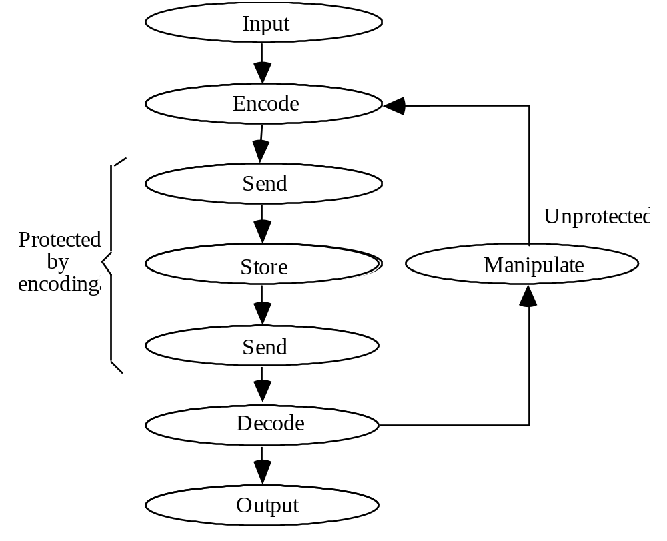
27.1 Faults, Errors, and Error Codes
Fig. 27.1
A common way of applying information coding techniques.

Slide 46
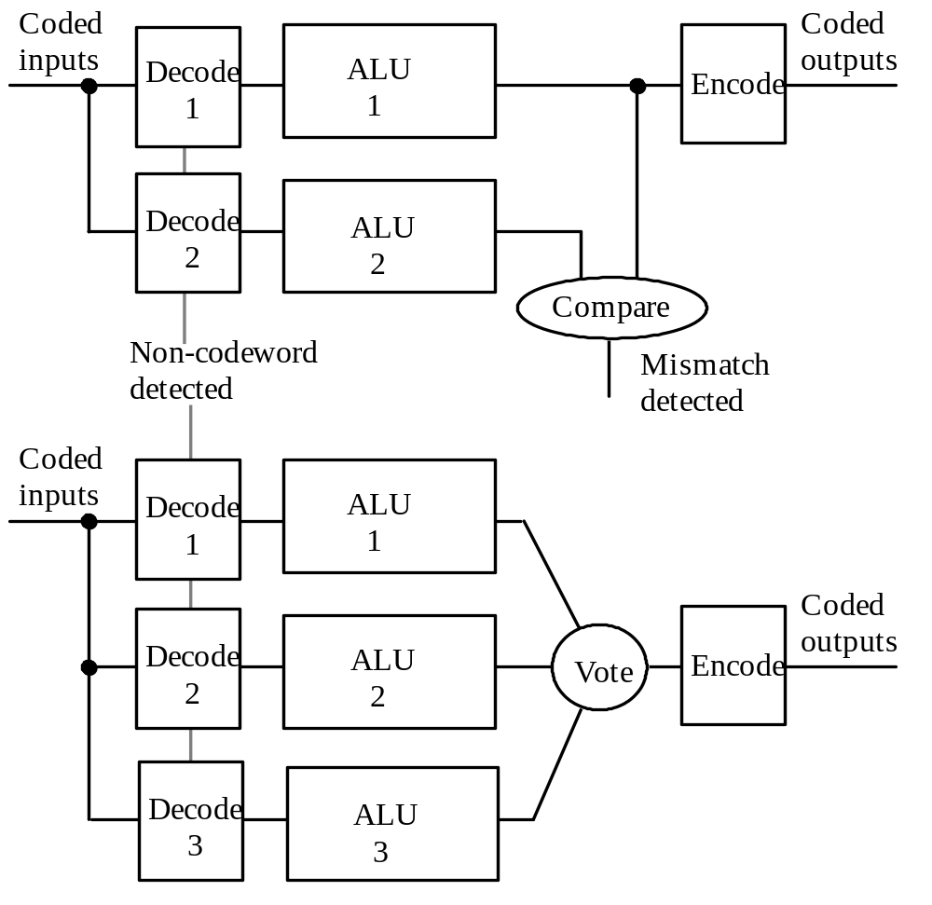
Fault Detection and Fault Masking
Fig. 27.2 Arithmetic fault detection or fault tolerance (masking) with replicated units.

Slide 47
Inadequacy of Standard Error Coding Methods
Unsigned addition 0010 0111 0010 0001
+ 0101 1000 1101 0011
–––––––––––––––––
Correct sum 0111 1111 1111 0100
Erroneous sum 1000 0000 0000 0100
↑
Stage generating an
erroneous carry of 1
Fig. 27.3 How a single carry error can produce an arbitrary number of bit-errors (inversions).
The arithmetic weight of an error: Min number of signed powers of 2 that must be added to the correct value to produce the erroneous result
Example 1 Example 2
------------------------------------------------------------------------ --------------------------------------------------------------------------
Correct value 0111 1111 1111 0100 1101 1111 1111 0100
Erroneous value 1000 0000 0000 0100 0110 0000 0000 0100
Difference (error) 16 = 2⁴ –32752 = –2¹⁵ + 2⁴
Min-weight BSD 0000 0000 0001 0000 –1000 0000 0001 0000
Arithmetic weight 1 2
Error type Single, positive Double, negative

Slide 48
27.2 Arithmetic Error-Detecting Codes
Arithmetic error-detecting codes:
Are characterized by arithmetic weights of detectable errors
Allow direct arithmetic on coded operands
We will discuss two classes of arithmetic error-detecting codes, both of which are based on a check modulus A (usually a small odd number)
Product or AN codes
Represent the value N by the number AN
Residue (or inverse residue) codes
Represent the value N by the pair (N, C),
where C is N mod A or (N – N mod A) mod A

Slide 49
Product or AN Codes
For odd A, all weight-1 arithmetic errors are detected
Arithmetic errors of weight ≥ 2 may go undetected
e.g., the error 32 736 = 2¹⁵ – 2⁵ undetectable with A = 3, 11, or 31
Error detection: check divisibility by A
Encoding/decoding: multiply/divide by A
Arithmetic also requires multiplication and division by A
Product codes are nonseparate (nonseparable) codes
Data and redundant check info are intermixed

Slide 50
Low-Cost Product Codes
Low-cost product codes use low-cost check moduli of the form A = 2ª – 1
Multiplication by A = 2ª – 1: done by shift-subtract
Division by A = 2ª – 1: done a bits at a time as follows
Given y = (2ª – 1)x, find x by computing 2ª x – y
. . . xxxx 0000 – . . . xxxx xxxx = . . . xxxx xxxx
Unknown 2ª x Known (2ª – 1)x Unknown x
Theorem 27.1: Any unidirectional error with arithmetic weight of at most a – 1 is detectable by a low-cost product code based on A = 2ª – 1

Slide 51
Arithmetic on AN-Coded Operands
Add/subtract is done directly: Ax ± Ay = A(x ± y)
Direct multiplication results in: Aa × Ax = A²ax
The result must be corrected through division by A
For division, if z = qd + s, we have: Az = q(Ad) + As
Thus, q is unprotected
Possible cure: premultiply the dividend Az by A
The result will need correction
Square rooting leads to a problem similar to division
⎣√ A²x ⎦ = ⎣ A√ x ⎦ which is not the same as A ⎣√ x ⎦

Slide 52
Residue and Inverse Residue Codes
Represent N by the pair (N, C(N)), where C(N) = N mod A
Residue codes are separate (separable) codes
Separate data and check parts make decoding trivial
Encoding: given N, compute C(N) = N mod A
Low-cost residue codes use A = 2a – 1
Arithmetic on residue-coded operands
Add/subtract: data and check parts are handled separately
(x, C(x)) ± (y, C(y)) = (x ± y, (C(x) ± C(y)) mod A)
Multiply
(a, C(a)) × (x, C(x)) = (a × x, (C(a)×C(x)) mod A)
Divide/square-root: difficult

Slide 53
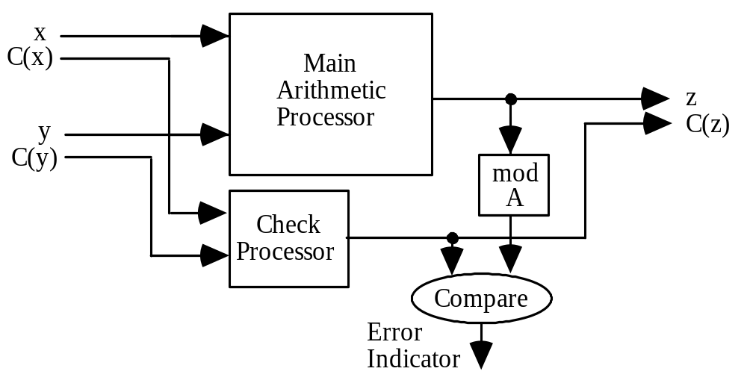
Arithmetic on Residue-Coded Operands
Add/subtract: Data and check parts are handled separately
(x, C(x)) ± (y, C(y)) = (x ± y, (C(x) ± C(y)) mod A)
Multiply
(a, C(a)) × (x, C(x)) = (a × x, (C(a)×C(x)) mod A)
Divide/square-root: difficult
Fig. 27.4
Arithmetic processor with residue checking.

Slide 54
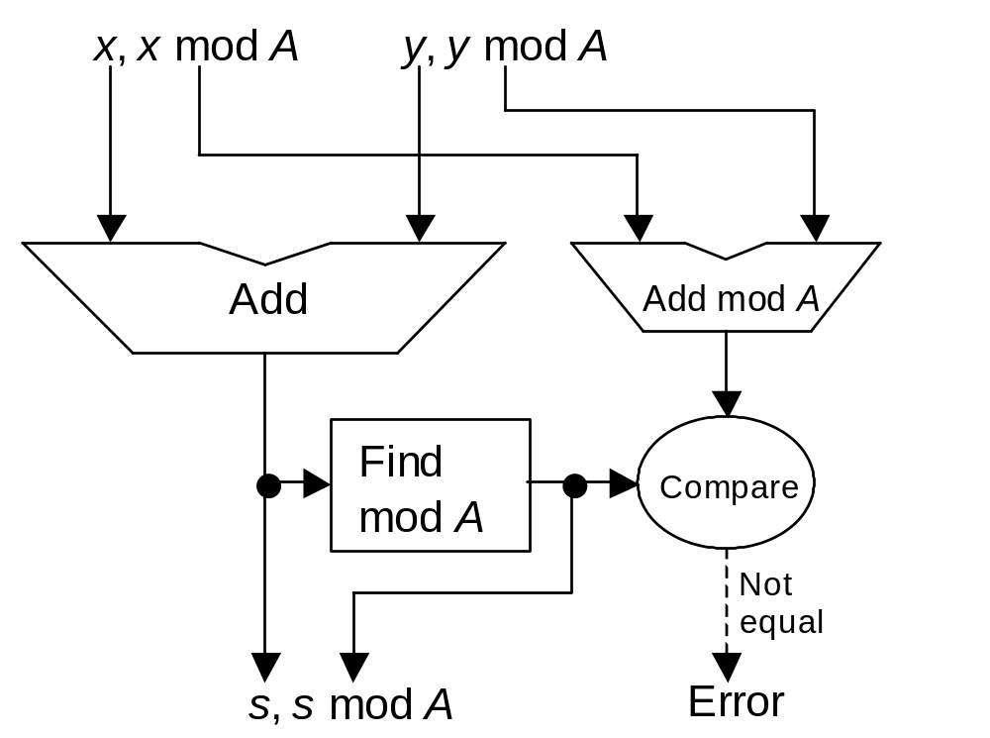
Example: Residue Checked Adder

Slide 55
27.3 Arithmetic Error-Correcting Codes
––––––––––––––––––––––––––––––––––––––––
Positive Syndrome Negative Syndrome
error mod 7 mod 15 error mod 7 mod 15
––––––––––––––––––––––––––––––––––––––––
1 1 1 –1 6 14
2 2 2 –2 5 13
4 4 4 –4 3 11
8 1 8 –8 6 7
16 2 1 –16 5 14
32 4 2 –32 3 13
64 1 4 –64 6 11
128 2 8 –128 5 7
256 4 1 –256 3 14
512 1 2 –512 6 13
1024 2 4 –1024 5 11
2048 4 8 –2048 3 7
––––––––––––––––––––––––––––––––––––––––
4096 1 1 –4096 6 14
8192 2 2 –8192 5 13
16,384 4 4 –16,384 3 11
32,768 1 8 –32,768 6 7
––––––––––––––––––––––––––––––––––––––––
Table 27.1
Error syndromes for weight-1 arithmetic errors in the (7, 15) biresidue code
Because all the symptoms in this table are different, any weight-1 arithmetic error is correctable by the (mod 7, mod 15) biresidue code

Slide 56

Properties of Biresidue Codes
Biresidue code with relatively prime low-cost check moduli A = 2ª – 1 and B = 2^{b} – 1 supports a × b bits of data for weight-1 error correction
Representational redundancy = (a + b)/(ab) = 1/a + 1/b

Slide 57
27.4 Self-Checking Function Units
Self-checking (SC) unit: any fault from a prescribed set does not affect the correct output (masked) or leads to a noncodeword output (detected)
An invalid result is:
Detected immediately by a code checker, or
Propagated downstream by the next self-checking unit
To build SC units, we need SC code checkers that never validate a noncodeword, even when they are faulty

Slide 58
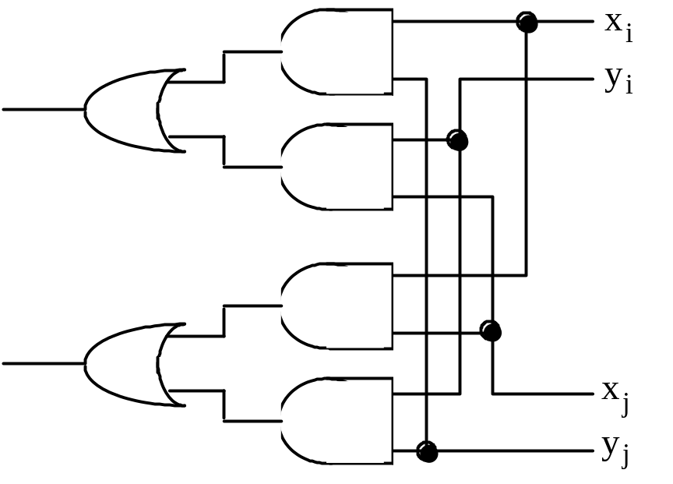
Design of a Self-Checking Code Checker
Example: SC checker for inverse residue code (N, C' (N))
N mod A should be the bitwise complement of C' (N)
Verifying that signal pairs (x_{i}, y_{i}) are all (1, 0) or (0, 1) is the same as finding the AND of Boolean values encoded as:
1: (1, 0) or (0, 1) 0: (0, 0) or (1, 1)
Fig. 27.5 Two-input
AND circuit, with 2-bit inputs (x_{i}, y_{i}) and (x_{i}, y_{i}),
for use in a self-checking code checker.

Slide 59
27.5 Algorithm-Based Fault Tolerance
Alternative strategy to error detection after each basic operation:
Accept that operations may yield incorrect results
Detect/correct errors at data-structure or application level
Example: multiplication of matrices X and Y yielding P
Row, column, and full checksum matrices (mod 8)
2 1 6 2 1 6 1
M = 5 3 4 M_{r} = 5 3 4 4
3 2 7 3 2 7 4
2 1 6 2 1 6 1
5 3 4 5 3 4 4
3 2 7 3 2 7 4
2 6 1 2 6 1 1
Fig. 27.6 A 3 × 3 matrix M with its row, column, and full checksum matrices M_{r}, M_{c}, and M_{f}.
M_{c} = M_{f} =

Slide 60
Properties of Checksum Matrices
Theorem 27.3: If P = X × Y , we have P_{f} = X_{c} × Y_{r}
(with floating-point values, the equalities are approximate)
2 1 6 2 1 6 1
M = 5 3 4 M_{r} = 5 3 4 4
3 2 7 3 2 7 4
2 1 6 2 1 6 1
5 3 4 5 3 4 4
3 2 7 3 2 7 4
2 6 1 2 6 1 1
Fig. 27.6
M_{c} = M_{f} =
Theorem 27.4: In a full-checksum matrix, any single erroneous element can be corrected and any three errors can be detected

Slide 61
27.6 Fault-Tolerant RNS Arithmetic
Residue number systems allow very elegant and effective error detection and correction schemes by means of redundant residues (extra moduli)
Example: RNS(8 | 7 | 5 | 3), Dynamic range M = 8 × 7 × 5 × 3 = 840; redundant modulus: 11. Any error confined to a single residue detectable.
Error detection (the redundant modulus must be the largest one, say m):
1. Use other residues to compute the residue of the number mod m
(this process is known as base extension)
2. Compare the computed and actual mod-m residues
The beauty of this method is that arithmetic algorithms are completely unaffected; error detection is made possible by simply extending the dynamic range of the RNS

Slide 62
Example RNS with two Redundant Residues
RNS(8 | 7 | 5 | 3), with redundant moduli 13 and 11
Representation of 25 = (12, 3, 1, 4, 0, 1)_{RNS}
Corrupted version = (12, 3, 1, 6, 0, 1)_{RNS}
Transform (–,–,1,6,0,1) to (5,1,1,6,0,1) via base extension
Reconstructed number = ( 5, 1, 1, 6, 0, 1)_{RNS}
The difference between the first two components of the corrupted and reconstructed numbers is (+7, +2)
This constitutes a syndrome, allowing us to correct the error

Slide 63
28 Past, Present, and Future
Chapter Goals
Wrap things up, provide perspective, and
examine arithmetic in a few key systems
Chapter Highlights
One must look at arithmetic in context of
• Computational requirements
• Technological constraints
• Overall system design goals
• Past and future developments
Current trends and research directions?

Slide 64
Past, Present, and Future: Topics
Topics in This Chapter
28.1. Historical Perspective
28.2. An Early High-Performance Machine
28.3. A Modern Vector Supercomputer
28.4. Digital Signal Processors
28.5. A Widely Used Microprocessor
28.6. Trends and Future Outlook

Slide 65
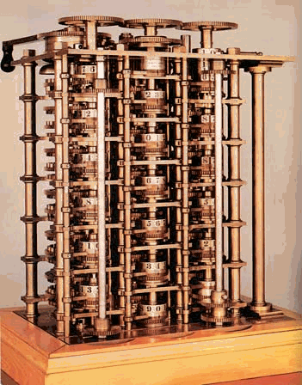
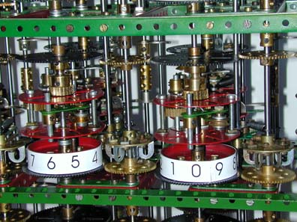
28.1 Historical Perspective
Babbage was aware of ideas such as carry-skip addition, carry-save addition, and restoring division
Modern reconstruction from Meccano parts;
http://www.meccano.us/difference_engines/
1848

Slide 66
Computer Arithmetic in the 1940s
Machine arithmetic was crucial in proving the feasibility of computing with stored-program electronic devices
Hardware for addition/subtraction, use of complement representation, and shift-add multiplication and division algorithms were developed and fine-tuned
A seminal report by A.W. Burkes, H.H. Goldstein, and J. von Neumann contained ideas on choice of number radix, carry propagation chains, fast multiplication via carry-save addition, and restoring division
State of computer arithmetic circa 1950:
Overview paper by R.F. Shaw [Shaw50]

Slide 67
Computer Arithmetic in the 1950s
The focus shifted from feasibility to algorithmic speedup methods and cost-effective hardware realizations
By the end of the decade, virtually all important fast-adder designs had already been published or were in the final phases of development
Residue arithmetic, SRT division, CORDIC algorithms were proposed and implemented
Snapshot of the field circa 1960:
Overview paper by O.L. MacSorley [MacS61]

Slide 68
Computer Arithmetic in the 1960s
Tree multipliers, array multipliers, high-radix dividers, convergence division, redundant signed-digit arithmetic were introduced
Implementation of floating-point arithmetic operations in hardware or firmware (in microprogram) became prevalent
Many innovative ideas originated from the design of early supercomputers, when the demand for high performance,
along with the still high cost of hardware, led designers to novel
and cost-effective solutions
Examples reflecting the sate of the art near the end of this decade:
IBM’s System/360 Model 91 [Ande67]
Control Data Corporation’s CDC 6600 [Thor70]

Slide 69
Computer Arithmetic in the 1970s
Advent of microprocessors and vector supercomputers
Early LSI chips were quite limited in the number of transistors or logic gates that they could accommodate
Microprogrammed control (with just a hardware adder) was a natural choice for single-chip processors which were not yet expected to offer high performance
For high end machines, pipelining methods were perfected to allow the throughput of arithmetic units to keep up with computational demand in vector supercomputers
Examples reflecting the state of the art near the end of this decade:
Cray 1 supercomputer and its successors

Slide 70
Computer Arithmetic in the 1980s
Spread of VLSI triggered a reconsideration of all arithmetic designs in light of interconnection cost and pin limitations
For example, carry-lookahead adders, thought to be ill-suited to VLSI, were shown to be efficiently realizable after suitable modifications. Similar ideas were applied to more efficient VLSI tree and array multipliers
Bit-serial and on-line arithmetic were advanced to deal with severe pin limitations in VLSI packages
Arithmetic-intensive signal processing functions became driving forces for low-cost and/or high-performance embedded hardware: DSP chips

Slide 71
Computer Arithmetic in the 1990s
No breakthrough design concept
Demand for performance led to fine-tuning of arithmetic algorithms and implementations (many hybrid designs)
Increasing use of table lookup and tight integration of arithmetic unit and other parts of the processor for maximum performance
Clock speeds reached and surpassed 100, 200, 300, 400, and 500 MHz in rapid succession; pipelining used to ensure smooth flow of data through the system
Examples reflecting the state of the art near the end of this decade:
Intel’s Pentium Pro (P6) → Pentium II
Several high-end DSP chips

Slide 72
Computer Arithmetic in the 2000s
Partial list, based on the first half of the decade
Continued refinement of many existing methods, particularly those based on table lookup
New challenges posed by multi-GHz clock rates
Increased emphasis on low-power design
Reexamination of the IEEE 754 floating-point standard

Slide 73
28.2 An Early High-Performance Machine
IBM System 360 Model 91 (360/91, for short; mid 1960s)
Part of a family of machines with the same instruction-set architecture
Had multiple function units and an elaborate scheduling and interlocking hardware algorithm to take advantage of them for high performance
Clock cycle = 20 ns (quite aggressive for its day)
Used 2 concurrently operating floating-point execution units performing:
Two-stage pipelined addition
12 × 56 pipelined partial-tree multiplication
Division by repeated multiplications (initial versions of the machine
sometimes yielded an incorrect LSB for the quotient)

Slide 74
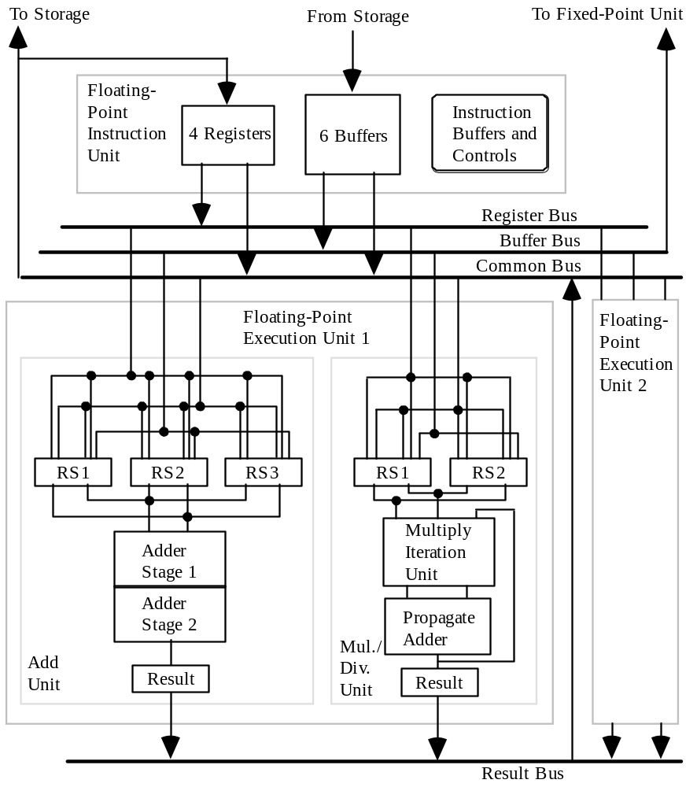
The IBM System 360 Model 91
Fig. 28.1 Overall structure of the IBM System/360 Model 91 floating-point execution unit.

Slide 75
28.3 A Modern Vector Supercomputer
Cray X-MP/Model 24 (multiple-processor vector machine)
Had multiple function units, each of which could produce a new result on every clock tick, given suitably long vectors to process
Clock cycle = 9.5 ns
Used 5 integer/logic function units and 3 floating-point function units
Integer/Logic units: add, shift, logical 1, logical 2, weight/parity
Floating-point units: add (6 stages), multiply (7 stages),
reciprocal approximation (14 stages)
Pipeline setup and shutdown overheads
Vector unit not efficient for short vectors (break-even point)
Pipeline chaining

Slide 76
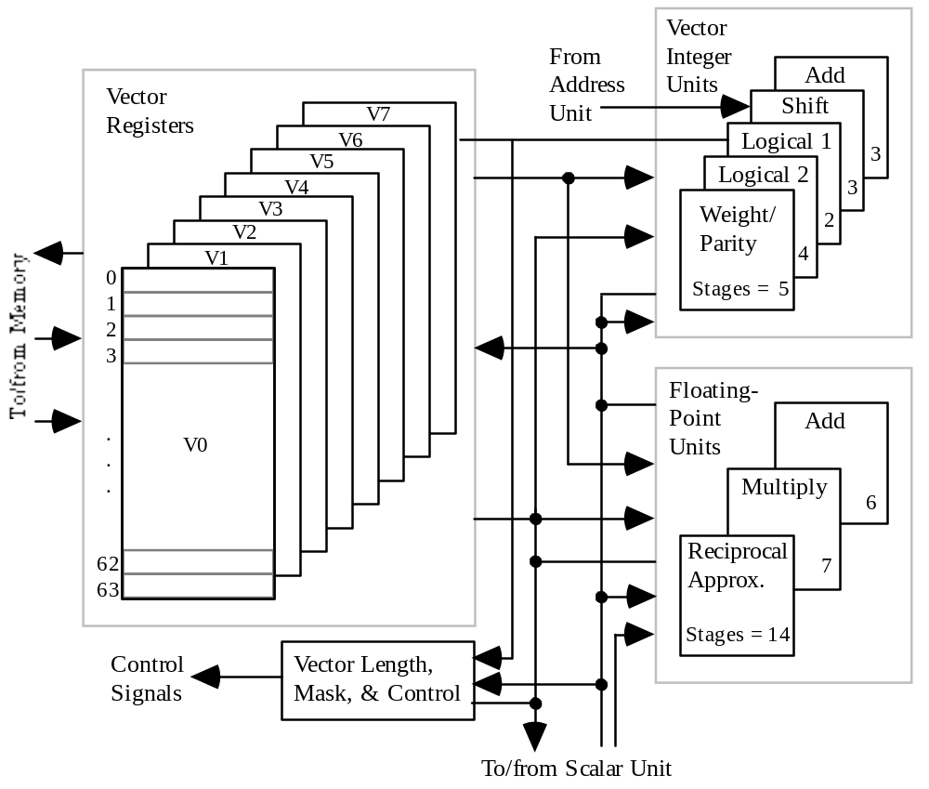
Cray X-MP Vector Computer
Fig. 28.1 The vector section of one of the processors in the Cray X-MP/ Model 24 supercomputer.

Slide 77
28.4 Digital Signal Processors
Special-purpose DSPs have used a wide variety of unconventional arithmetic methods; e.g., RNS or logarithmic number representation
General-purpose DSPs provide an instruction set that is tuned to the needs of arithmetic-intensive signal processing applications
Example DSP instructions
ADD A, B { A + B → B }
SUB X, A { A – X → A }
MPY ±X1, X0, B { ±X1 × X0 → B }
MAC ±Y1, X1, A { A ± Y1 × X1 → A }
AND X1, A { A AND X1 → A }
General-purpose DSPs come in integer and floating-point varieties

Slide 78
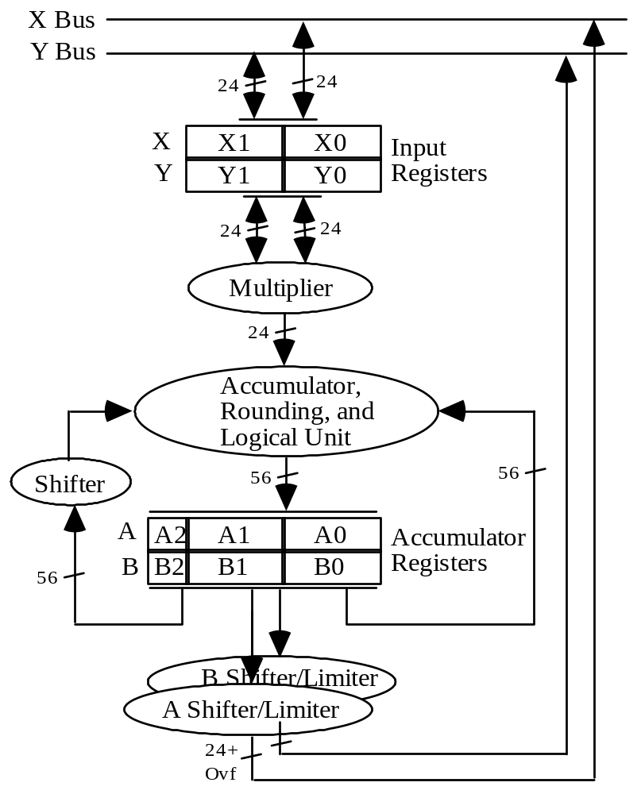
Fixed-Point
DSP Example
Fig. 28.3 Block diagram of the data ALU in Motorola’s DSP56002 (fixed-point) processor.

Slide 79
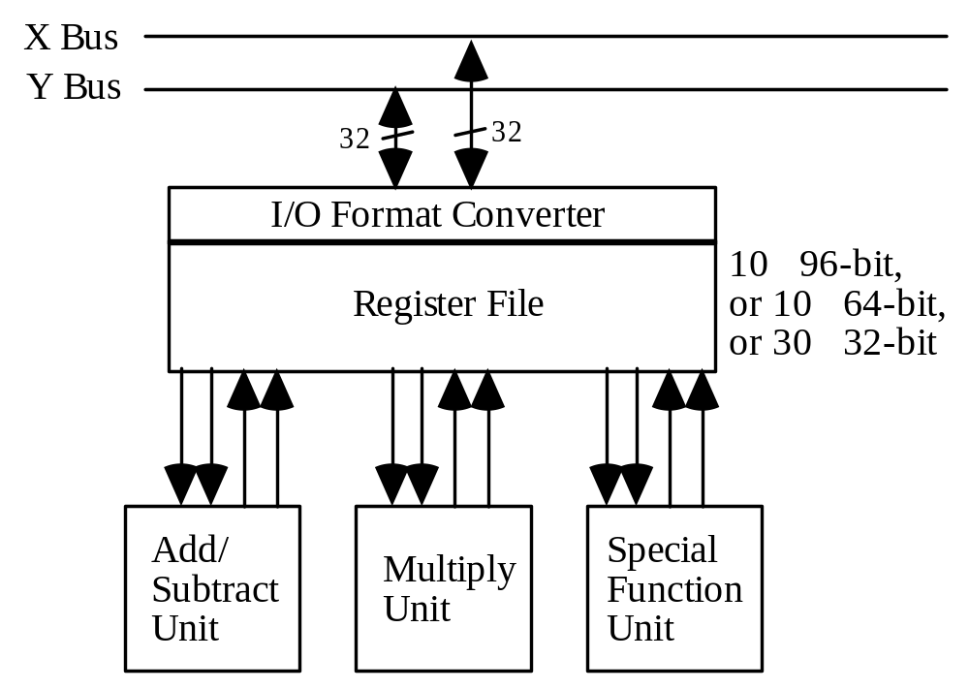
Floating-Point
DSP Example
Fig. 28.4 Block diagram of the data ALU in Motorola’s DSP96002 (floating-point) processor.

Slide 80
28.5 A Widely Used Microprocessor
In the beginning, there was the 8080; led to the 80x86 = IA32 ISA
Half a dozen or so pipeline stages
80286
80386
80486
Pentium (80586)
A dozen or so pipeline stages, with out-of-order instruction execution
Pentium Pro
Pentium II
Pentium III
Celeron
Two dozens or so pipeline stages
Pentium 4
More advanced technology
Instructions are broken into micro-ops which are executed out-of-order but retired in-order
More advanced technology

Slide 81
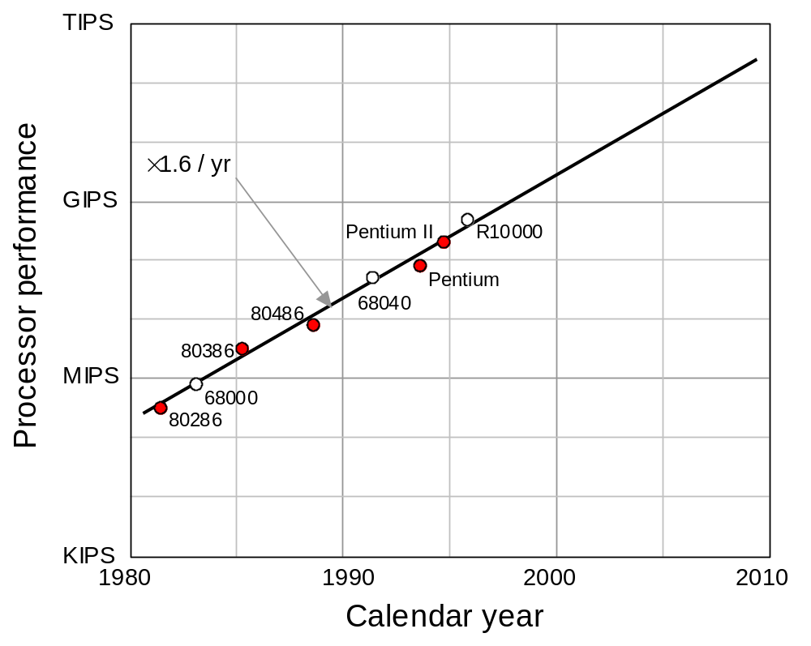
Performance Trends in Intel Microprocessors

Slide 82
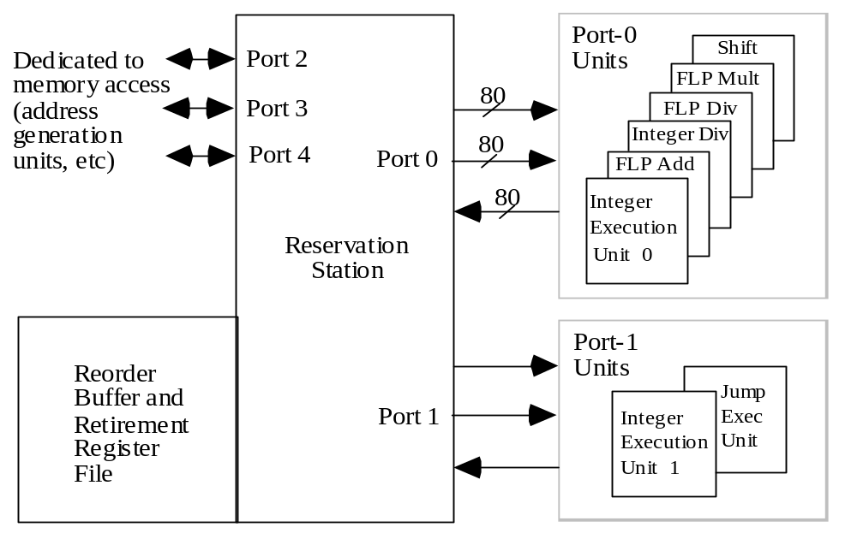
Arithmetic in the Intel Pentium Pro Microprocessor
Fig. 28.5 Key parts of the CPU in the Intel Pentium Pro (P6) microprocessor.

Slide 83
28.6 Trends and Future Outlook
Current focus areas in computer arithmetic
Design: Shift of attention from algorithms to optimizations at the level of transistors and wires
This explains the proliferation of hybrid designs
Technology: Predominantly CMOS, with a phenomenal rate of improvement in size/speed
New technologies cannot compete
Applications: Shift from high-speed or high-throughput designs in mainframes to embedded systems requiring
Low cost
Low power

Slide 84
Ongoing Debates and New Paradigms
Renewed interest in bit- and digit-serial arithmetic as mechanisms to reduce the VLSI area and to improve packageability and testability
Synchronous vs asynchronous design (asynchrony has some overhead, but an equivalent overhead is being paid for clock distribution and/or systolization)
New design paradigms may alter the way in which we view or design arithmetic circuits
Neuronlike computational elements
Optical computing (redundant representations)
Multivalued logic (match to high-radix arithmetic)
Configurable logic
Arithmetic complexity theory

Slide 85
The End!
You’re up to date. Take my advice and try to keep it that way. It’ll be tough to do; make no mistake about it. The phone will ring and it’ll be the administrator –– talking about budgets. The doctors will come in, and they’ll want this bit of information and that. Then you’ll get the salesman. Until at the end of the day you’ll wonder what happened to it and what you’ve accomplished; what you’ve achieved.
That’s the way the next day can go, and the next, and the one after that. Until you find a year has slipped by, and another, and another. And then suddenly, one day, you’ll find everything you knew is out of date. That’s when it’s too late to change.
Listen to an old man who’s been through it all, who made the mistake of falling behind. Don’t let it happen to you! Lock yourself in a closet if you have to! Get away from the phone and the files and paper, and read and learn and listen and keep up to date. Then they can never touch you, never say, “He’s finished, all washed up; he belongs to yesterday.”
Arthur Hailey, The Final Diagnosis

